Slide 1
Robot Intellij Plugin
Adding Custom Language support to Intellij
Charles Capps

Slide 2

Why do such a crazy thing?

Slide 3
Why write a custom language plugin?
The Robot Framework is used for our UI Test automation
Back in February, there were no Intellij plugins for Robot
Even now, the Robot Plugin is the only one with Java support
Makes coding so much more efficient and less error-prone!
Search features help you find Test Cases and Keywords
Refactoring support saves time, and saves Jive money!

Slide 4
Demos of Features

Slide 5
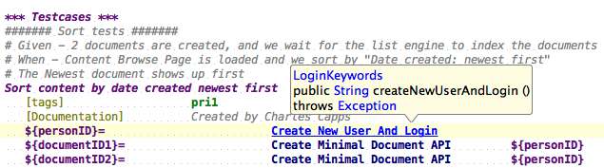
Resolving References to Declaration
Resolve Keyword to declaration in Java or Robot
Resolve Variable to local declaration or Variables table
Resolve Resource Files

Slide 6
Resolve Reference - Live demo time!

Slide 7
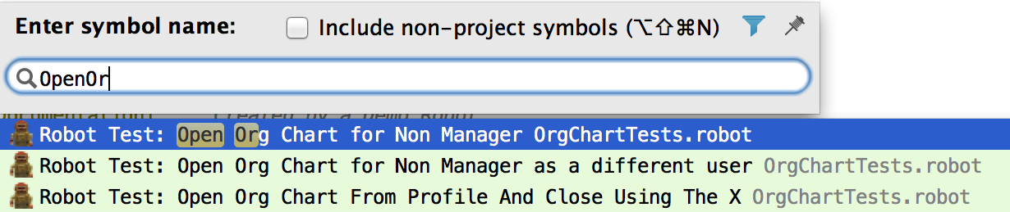
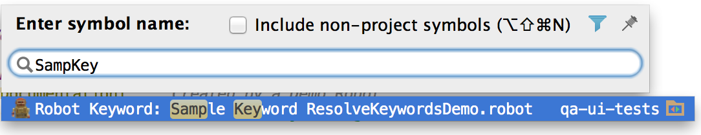
Searching for Test Cases and Keywords
Previously, you could only search by exact text occurrences
Now, can use Navigate → Symbol or ctrl+shift+alt+n

Slide 8
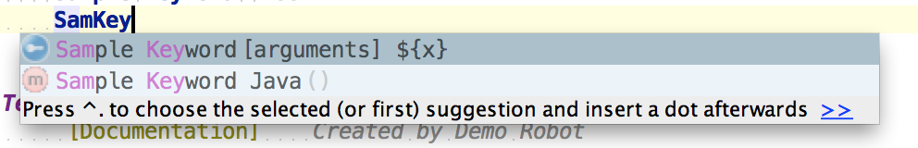
Autocomplete Keywords, Tags, and Variables
Start typing in a context where a Robot Keyword can be used
Results will pop-up automatically!
Made a conscious decision for Keyword autocomplete to use all keywords in the project, not just Keywords in scope (give explanation)
Variables – complete from variables in local scope, or included in Resource files.

Slide 9
Autocomplete - Live demo time!

Slide 10
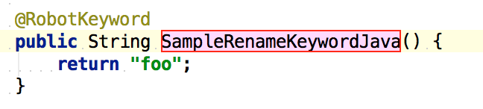
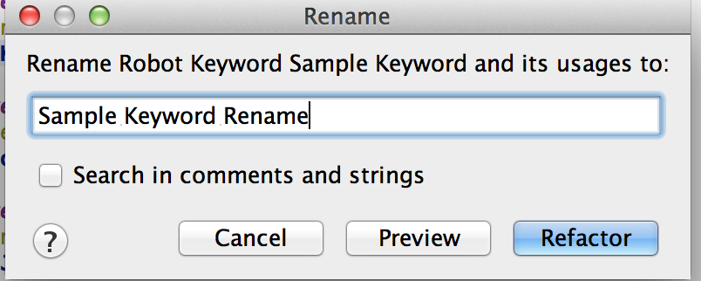
Rename Refactoring
Rename Java Keywords or Robot Keywords with Shift+F6
All usages will be renamed
Rename Variables – will smartly rename usages for the right scope
Rename Robot Files – Resource Settings will be renamed

Slide 11
Rename Refactoring - Live demo time!

Slide 12
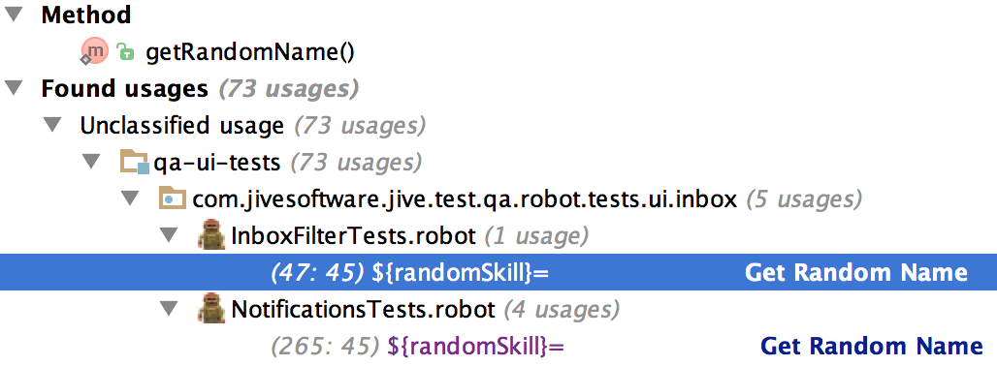
Find Usages of Keywords and Variables
To Find Usages: Right-click → Find Usages, or Ctrl+F7
Keep in mind, Robot is case-insensitive and doesn’t care about spaces and underscores.

Slide 13
Find Usages - Live demo time!

Slide 14
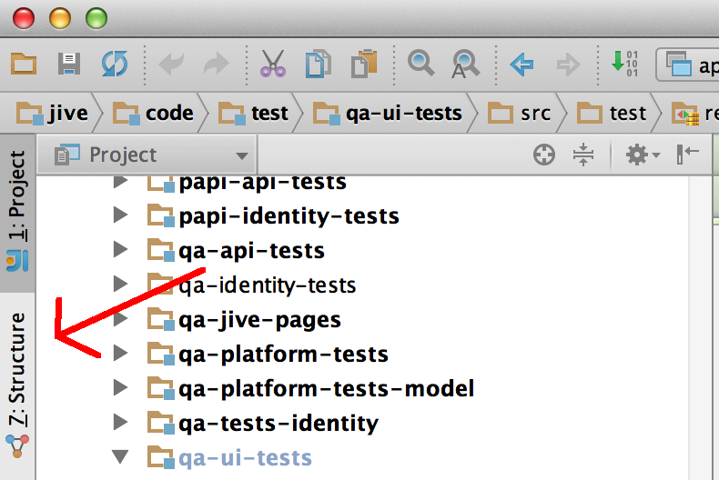
Structure View
See at a glance what Test Cases and Keywords are in a Robot File

Slide 15
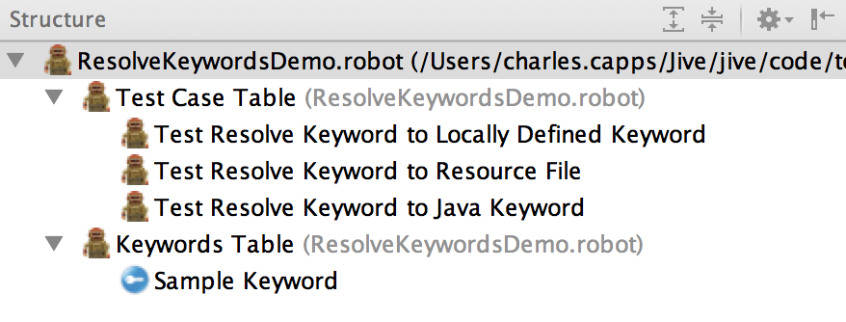
Structure View
Displays all Test Case Tables and Keywords Tables

Slide 16
Under the Hood – How does it work?

Slide 17
Step 1. Implement a Lexer

Slide 18
Step 1. Implement a Lexer
A lexer converts plain text into a sequence of Tokens.
Tokens determine Syntax Highlighting.
Intellij requires you to implement interface com.intellij.lexer.FlexLexer
The Grammar Kit Plugin comes in handy.
The Grammar Kit generates a Lexer from a JFlex file, .flex extension.

Slide 19
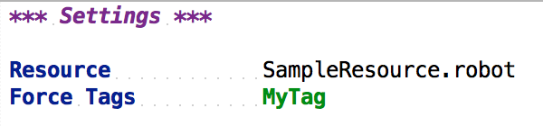
Example Lexing
=
[ SETTINGS_TABLE_HEADING_TOKEN, NEWLINE_TOKEN,
NEWLINE_TOKEN,
RESOURCE_SETTING_TOKEN, COLUMN_SEP_TOKEN,
ROBOT_FILE_TOKEN, NEWLINE_TOKEN,
FORCE_TAGS_SETTING_KEYWORD_TOKEN, COLUMN_SEP_TOKEN,
TAG_TOKEN ]

Slide 20
Step 2. Implement a Parser.

Slide 21
Step 2. Implement a Parser.
Parser converts the Tokens into an Abstract Syntax Tree (AST)
AST is a tree representation of code.
Leaves of the tree are Tokens.
Branches of the tree are Program Structure Interface (PSI) elements
Intellij requires you to implement com.intellij.lang.PsiParser
Parser is generated from a BNF file (.bnf) using the Grammar Kit.

Slide 22
Example AST
=

Slide 23
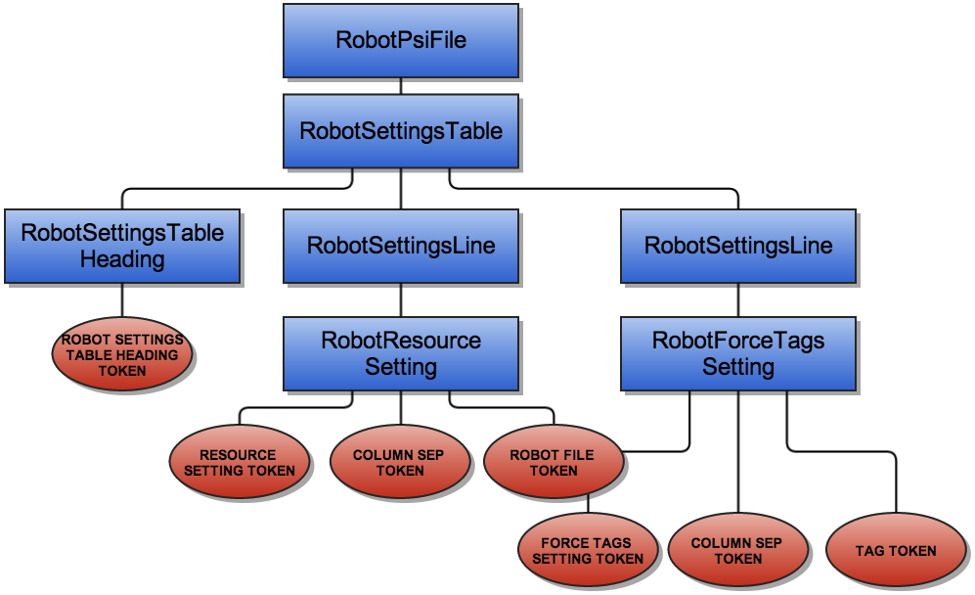
Example AST

